Slide 1
Adult Nursing
Prepared by:
Meldrick Magsino
Practice Educator, East & North Hertfordshire NHS Trust

Slide 2
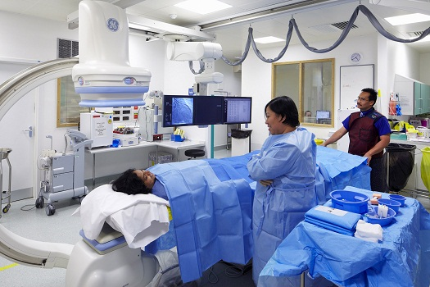
What is Adult Nursing?
Adult nursing specializes in caring for people aged 18 and above.
It involves helping adults with health conditions like heart disease, accidental injuries, pneumonia, arthritis, and even cancer.

Slide 3
How to become one?
Degree course at a university
Nurse degree apprenticeships
Nursing associate apprenticeships
Check out universities now

Slide 4
Must have skills
Communication and interpersonal skills
Planning and decision-making
Ability to teach and advise
Time management
Working with patience and compassion

Slide 5
Entry Requirements
Each university sets its own entry criteria, but you are likely to need:
at least two (usually three) A-levels or equivalent qualifications at level 3
supporting GCSEs including English, maths and a science (usually biology or human biology)
Contact universities directly to find out whether qualifications equivalent to A-levels or GCSEs are acceptable.

Slide 6
Entry Requirements
Courses often specify preferred or essential A-level or equivalent subjects, such as one science (for example biology) or social science (for example psychology).
Some universities offer courses with a foundation year for those without the necessary entry qualifications.

Slide 7
Benefits of pursuing the course
Fast employment – 94% are employed 6 months after graduation
Adequate support – student loans, financial aids
Chance to make a real difference – saving people’s lives

Slide 8
Benefits upon employment
Wide range of opportunities and specialities to choose from
Working with expert health professionals from various fields
Standard working week – 37.5 hours

Slide 9
Benefits upon employment
Paid on the Agenda for Change (AFC) pay system, typically starting as Band 5
Access to NHS Pension Scheme and health service discounts
27 days of annual leave plus bank holidays

Slide 10
Testimonial video 1
https://youtu.be/fZFS2Mjbv5A

Slide 11
Testimonial Video 2
https://youtu.be/iDu1kbtjcn4

Slide 12
References
https://www.nmc.org.uk
www.healthcareers.nhs.uk

